Slide 1
Operators and Expressions

Slide 2

What are operators and expressions?
Programs use data stored in variables and perform different types of operations on that data.
The data on which operations are performed are known as operands and the types of the operations performed on them are known as operators.
The combination of operators and expressions are known as expressions Consider the following c++ statement: z * y
z and y are the operands
* (multiplication is the operator
z * y is an expression

Slide 3
Category of Operators
Based on the number of operands there are three basic types of operators :
Unary Operators: they work on a single operand
Binary Operators: they work on two operands
Ternary Operators: they work on three operands

Slide 4






















Types of Operators
Operators
Arithmetic
Relational
Logical
Assignment
Special
>, <, >=, <=, !=,==
&&, !, ||
=
Unary
Binary
Conditional
C++
Shorthands
+, -,++, - -
+, -, *, /, %
? (true) :false)
+=,-=.*=,/=,%=

Slide 5
Arithmetic operators
#include<iostream.h> void main()
{
int a, b; a=40, b=20;
cout<<“\n Sum of a and b :”<<a+b; cout<<“\n Difference of a and b :”<<a-b; cout<<“\n Product of a and b :”<<a*b; cout<<“\n Quotient of a and b :”<<a/b;
}
These operators are used to perform simple arithmetic calculations like addition, subtraction , multiplication and division
All the arithmetic operators are binary in nature.
Only the – operator can be both unary or binary
Sum of a and b :60 Difference of a and b :20 Product of a and b :800 Quotient of a and b :2

Slide 6
Points to note about arithmetic operators
They can be used with all data types.
The division operator (/) does integer division only. This means if we divide say 45 by 6, we will get the answer as 7 and not 7.5 as expected. This is because the
/ operator discards the decimal part after division.
To get the accurate answer in the above case we must write 45.0/6.0.
#include<iostream.h> void main()
{
cout<<“Divide one :”<<45/6;
cout<<“\n Divide Two :”<<45.0/6.0;
}
Divide one : 7 Divide Two : 7.5

Slide 7
Points to note about arithmetic operators
Another way to get the accurate result would be to store the numbers in float variables.
#include<iostream.h> void main()
{
float a, b; a=45, b=6;
cout<<“\n a/ b = :”<<a/b;
}
a/b= : 7.5

Slide 8
The modulus ( % ) operator
The modulus operator , represented by the percentage sign( %) gives the remainder of division. For example
#include<iostream.h> void main()
{
int a, b;
a=25, b=12;
cout<<“\n Quotient of a and b :”<<a/b; cout<<“\n Remainder of division is :”<<a % b;
}
2 )25 ( 12
2
5
4
Quotient( 25/2 )
Quotient of a and b :12 Remainder of division is : 1
1 Remainder( 25 % 2)
The modulus operator can be used only with integers.

Slide 9
Arithmetic operators and char data
01
We can only use the addition and subtraction operator with variables of char data type.
02
This is possible because data ( character or symbol) is stored in a char variable as an integer value equal to the ASCII code of the character.
03
In the statement: char ch = ‘A’;
the ASCII equivalent of ‘A’ i.e. 65 is stored in ch.
04
So if we write ch=ch+1;We are actually adding 1 to 65, which becomes 66. Thus ch will now store the letter ‘B’ whose ASCII code is 66

Slide 10
Arithmetic operators and char data
#include<iostream.h> void main()
{
char ch=‘A’ ;
cout<<“The value of character variable is:”<<ch; ch=ch+1;
cout<<“\n The value after adding 1 :”<<ch;
}
The value of character variable is: A The value after adding 1 : B

Slide 11
Relational Operators
Relational operators are used to form conditions in an expression.
They are mainly used to compare variables with other variables or constants.
They are binary in nature
Operator | Description | Expression
> | Greater than | a>b
< | Less than | a<b
>= | Greater than or equal to | a>=b
<= | Less than or equal to | a<=b
== | Equal to | a==b
!= | Not equal to | a!=b

Slide 12
Relational Operators
The result of a relational expression is either true(1) or false (0).
Variable value Example Expression |  | Result
a=9, b=8 | a>b a>=b a==b a!=b a>2 | True or 1 True or 1 False or 0 True or 1 True or 1
a=9, b=9 | a>=b a==b a!=b b>9 | True or 1 True or 1 False or 0 False or 0

Slide 13
Using Relational Operators
#include<iostream.h> void main()
{
int a=2, b=1,c=4,d=6,e=9,f=-6; cout<<(a>b)<<endl; cout<<(b>c)<<endl; cout<<(d<=e)<<endl; cout<<(e!=f)<<endl; cout<<(c>=a)<<endl; cout<<(a==d);
}
1
0
1
1
1
0
#include<iostream.h> void main()
{
int a, b; a=20, b=12;
cout<<“\n a>b =”<<(a>b)<<“\t a!=b =“<< (a!=b); b=b+8;
cout<<“\n a>b =”<<(a>b)<<“\t a==b =”<<(a==b);
}
a>b = 1
a>b = 0
a!=b = 1
a==b = 1

Slide 14
Logical Operators
These operators are used to combine two or more conditions.
They return true or false.
In the table x and y denote conditions
Operator |  | Type | Example
&& | Logical And | Binary | x && y
|| | Logical Or | Binary | x || y
! | Logical Not | Unary | !x

Slide 15
Working of OR (||) operator
Variable value | Expression | Condition 1 | Result | Condition 2 | Result | Output of expression
x=15, y=7 | x>y || y >6 | x>y | True(1) | y>6 | True(1) | True(1)
 | x>y || y!= 4 | x>y | True(1) | y!=7 | False(0) | True(1)
 | x<y || y==4 | x<y | False(0) | y==7 | True(1) | True(1)
 | x<y || y>7 | x<y | False(0) | y>7 | False(0) | False(0)

Slide 16
Working of AND (&&) operator
Variable value | Expression | Condition 1 | Result | Condition 2 | Result | Output of expression
x=15, y=7 | x>y && y >6 | x>y | True(1) | y>6 | True(1) | True(1)
 | x>y && y!= 4 | x>y | True(1) | y!=7 | False(0) | False(0)
 | x<y && y==4 | x<y | False(0) | y==7 | True(1) | False(0)
 | x<y && y>7 | x<y | False(0) | y>7 | False(0) | False(0)

Slide 17
Working of NOT (!) operator
Variable value | Expression | Condition | Result | !(Condition ) | Output of expression
x=15, y=4 | ! (x>y ) | x>y | True(1) | ! (True ) | False(0)
 | ! (y>7) | y>7 | False(0) | ! (False) | True(1)
 | !(x>y || y!= 4) | T || F | True(1) | !(True) | False(0)
 | !(x<y || y>7) | F || F | False(0) | !(False) | True(1)

Slide 18

Assignment (=) Operator
The Assignment operator is used to assign a value to a variable.
X = 20;
In the example the variable x is assigned a value 20.
Variable
Value
The variable is always on the left hand side and the value on the right
hand side.
The value can be another variable or an expression. For eg:
a=b; p=q+r;
the value stored in variable b is assigned to a the sum of q and r is stored in the variable p

Slide 19
C++ Shorthands
These are operators used to perform an arithmetic function on an operand and assign the new value to the operand at the same time.
Operator | Description | Example | Equivalent to:
+= | Addition assignment | A+=B | A=A+B
-= | Subtraction assignment | A -=B | A=A-B
*= | Multiplication assignment | A*=B | A=A*B
/= | Division assignment | A/=B | A=A/B
%= | Modulus assignment | A%=B | A=A%B

Slide 20
Increment(++) / Decrement(--) Operators
The increment(++) and decrement(--) are unary operators . The syntax is : Examples:
variable ++; or
++ variable;
variable --;
or
-- variable;
a++;
++ x;
p=--q;
t--;
The increment / decrement operators do not work on constants.
Thus :
6++; //gives error as 6 is a constant x=--9; // gives error as 9 is a constant

Slide 21
Increment(++) / Decrement(--) Operators
The increment operator increases the value of a variable by 1 The decrement operator decreases the value of a variable by 1. Thus and
a++;
is the same as
a=a+1;
b--;
is the same as
b=b-1;

Slide 22
Increment(++) / Decrement(--) Operators
Both the increment and decrement operators can be prefixed or postfixed. i.e.
++a; (prefix) is the same as a++; (postfix)
In the above statements both prefix and postfix forms do not make any difference in the output as these are stand alone statements.
But when the pre/post increment or decrement operators are part of an
expression the prefix and postfix notation does matter

Slide 23

Increment(++) / Decrement(--) Operators Pre Increment
In the prefix form the increment or decrement operation is carried
out before the rest of the expression.
Consider the following code snippet:
Working
code
a b
a=a+1 b=a
int a,b;
a=3;
b=++a;
cout<<“a= ”<<a<<“\tb= ”<<b;
1
2
3 ₄
4
2
1
Explanation
output
 | a= | 4 | b= | 4
The value of the variable a is incremented first
The new value (4) is assigned to b.
Thus the value of a and b both become 4

Slide 24
Increment(++) / Decrement(--) Operators Post Increment
In the prefix form the increment or decrement operation is carried
out before the rest of the expression.
Consider the following code snippet:
Working
code
a b
b=a a=a+1
1
2
int a, b ; a=3;
b=a++;
cout<<“a= “<<a<<“\tb= “<<b;
3 ₄
3
1
2
Explanation
output
 | a= | 4 | b= | 3
The value of the variable a(3) is assigned to b.
The variable a is incremented .
Thus the value of a and b both become 4

Slide 25
Program to illustrate Increment, Decrement operators
#include<iostream.h> void main()
{
int a,b,c,d; a = 0;
b = 2;
c = 4;
d = a -- + b++ - ++c;
cout<<“A= ”<<a<<“\tB= ” <<b<<“\tC= ”<<c“\tD = "<<d;
}
A= -1 B= 3 C= 5 D= 7

Slide 26

The Conditional operator ( ?: )
The conditional operator is a ternary operator having three operands.
It evaluates a condition and depending on whether it is true or false it carries out one of two statements.
Syntax:
Expression 1 ? Expression 2: Expression 3;
If Expression 1 which is a condition evaluates to true, expression 2 is carried out otherwise expression 3 is carried out.
Expression 2 and 3 can be any valid c++ statement

Slide 27


Conditional operator: illustration
Example :
Working
true
code
#include<iostream.h> void main()
{int a,b;
cout<<“Enter two numbers :”<<endl; cin>>a>>b;
cout<<“\n The larger no is :”; a>b? cout<<a : cout<<b;}
a>b? cout<<a : cout<<b; 1 2 3
false
output
Explanation
Enter two numbers : 24
22
The larger no is : 24
Expression 1 is evaluated
If it returns true, expression 2 is carried out.
If it returns false, expression 3 is carried out.

Slide 28
Conditional operator: illustration
The value generated by a conditional operator can also be assigned to a variable
Thus the previous program can also be written as:
true
code
Working
#include<iostream.h>
void main()
{int a,b, large;
cout<<“Enter two numbers :”<<endl; cin>>a>>b;
large = a>b? a : b;
cout<<“\n The larger no is :”<<large;
large=
a>b ? a : b; 1 2 3
false
output
Explanation
}
Enter two numbers :
24
22
The larger no is : 24
Expression 1 is evaluated.
If it returns true, large is assigned the value 24
If it returns false, large is assigned the value 22
In this case large will be assigned value 24

Slide 29
Conditional operator: illustration
The conditional operator can be used to choose which variable to assign a value to:
code
output
#include<iostream.h> void main()
{int score1, score2, Bonus_points ; cout<<“Enter the scores :”<<endl; cin>>score1>>score2; Bonus_points= score1 * score2;
(score1>score2) ? score1:score2= Bonus_points; cout<<“\n New scores :”<<score1<<“#”<<score2;
}
Enter the scores : 8
9
New Scores : 8 # 72

Slide 30


Slide 31
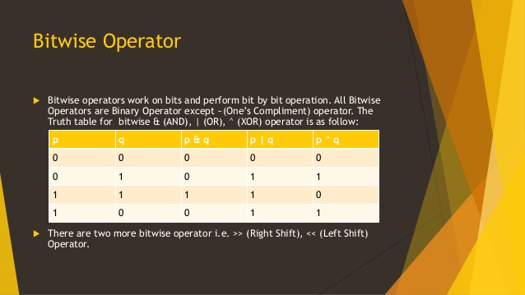

Slide 32
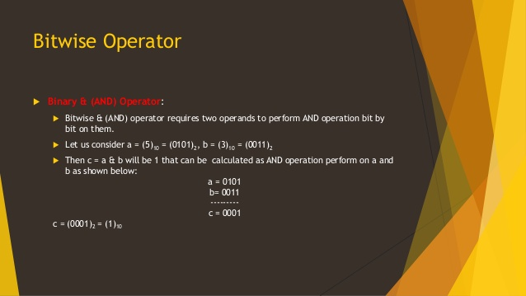

Slide 33
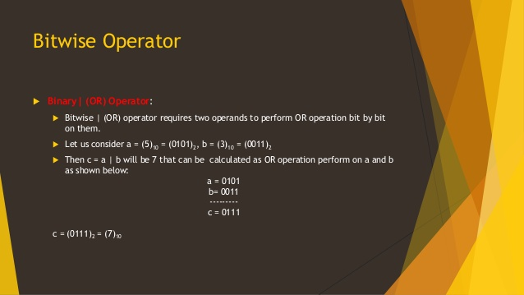

Slide 34


Slide 35
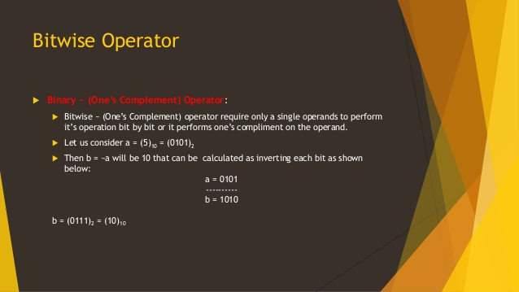

Slide 36
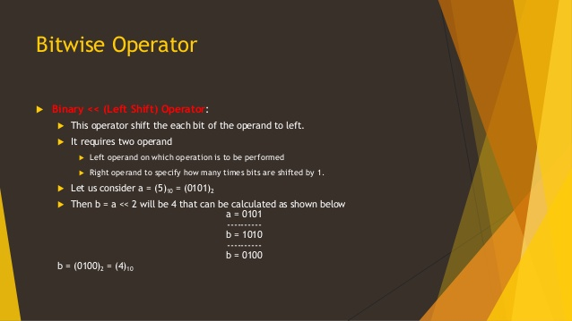

Slide 37
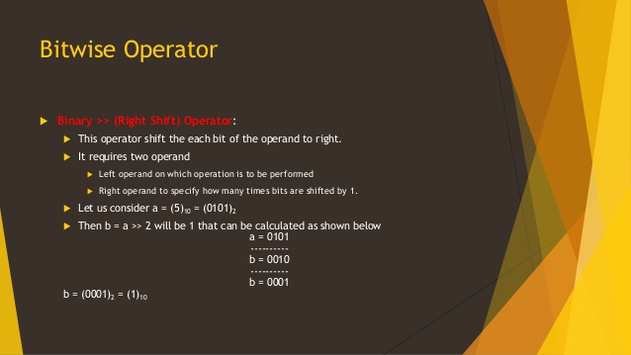

Slide 38
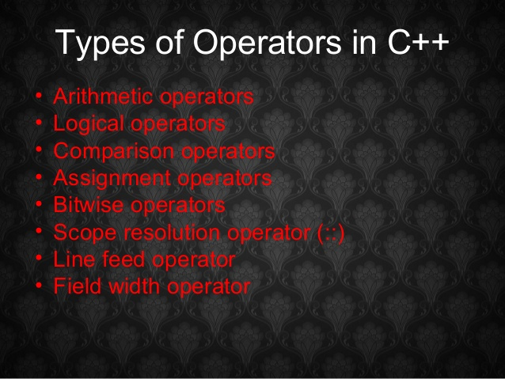

Slide 39
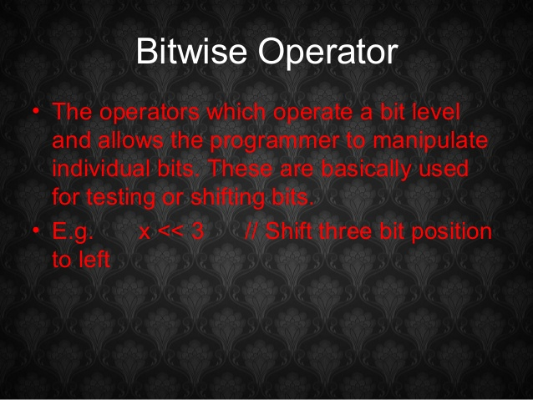

Slide 40
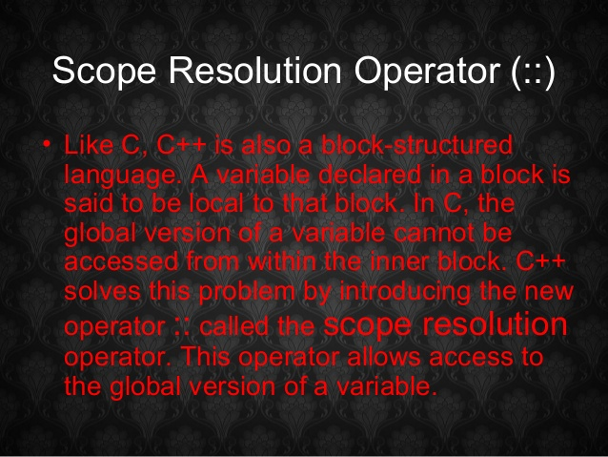

Slide 41
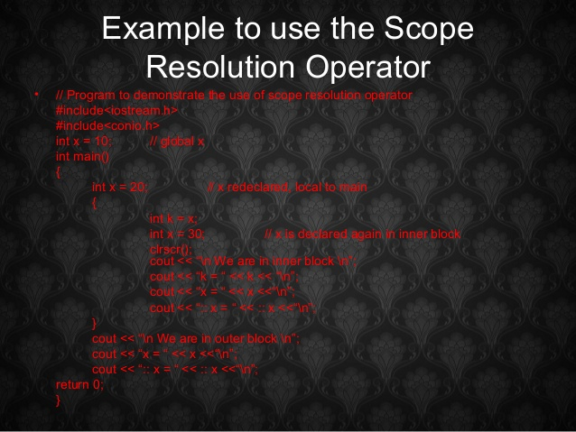
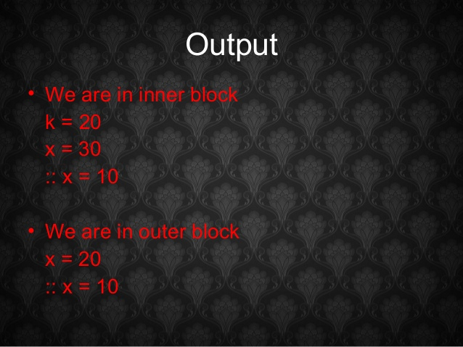

Slide 42
#include<iostream> using namespace std; int x=30; // Global x int main() { int x = 10; // Local x cout << "Value of global x is " << ::x; cout << "\n value of local x is " << x; return 0; }
Output:
Value of global x is 30
Value of local x is 10

Slide 43
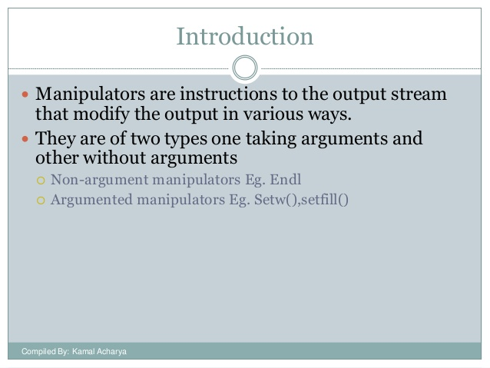

Slide 44
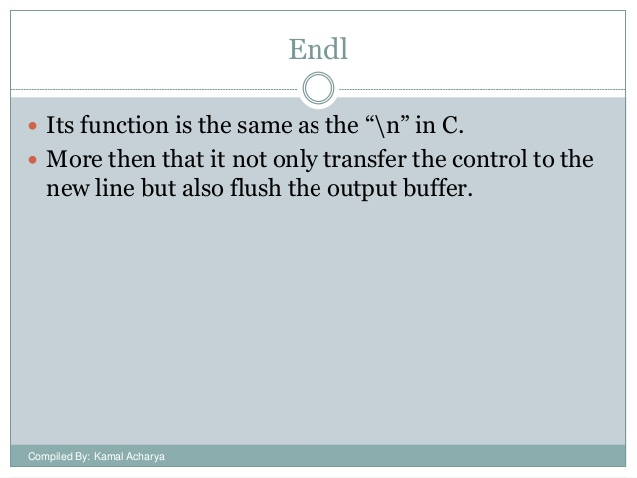

Slide 45
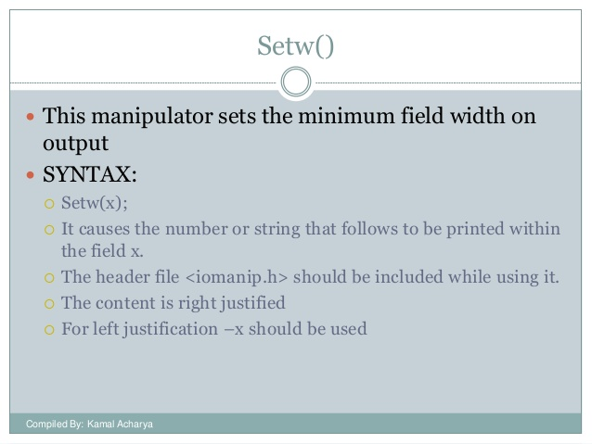

Slide 46
Expression & Expression Evaluation
Expressions are formed using any or all of the operators discussed so far.
arithmetic
x= r / y +p; p= 2* a* t;
Relational
x>y z!=p
Expressions
Logical
x >y && p<=z b>9 || v!=6
conditional
x= (a>b)? 0.9: 0.6;
x>y ? cout<<x: cout<<y;

Slide 47
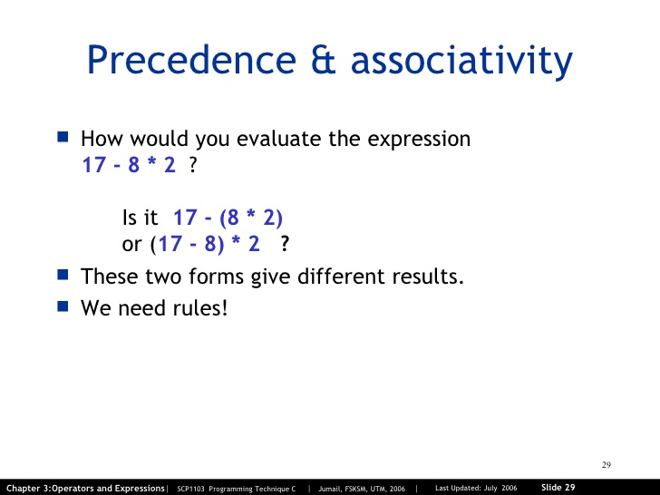

Slide 48
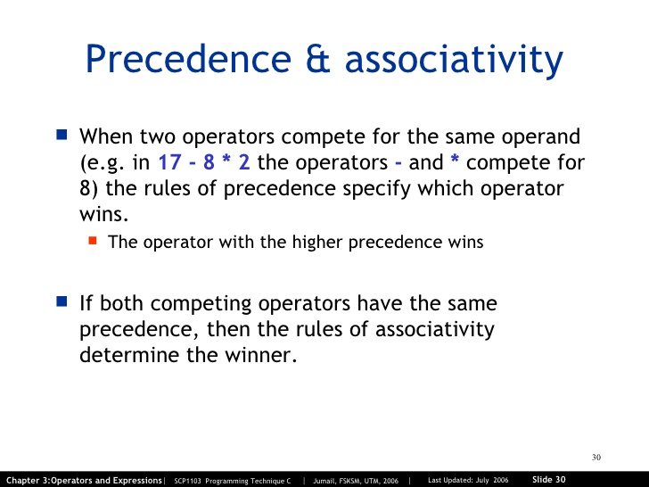

Slide 49
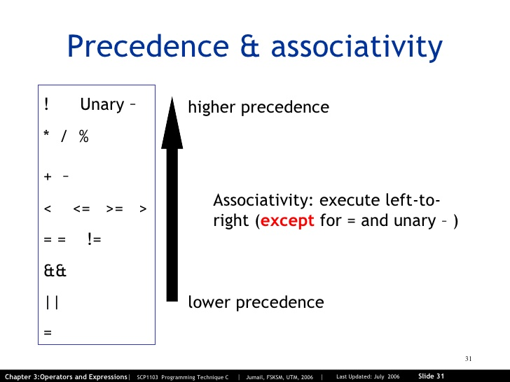

Slide 50
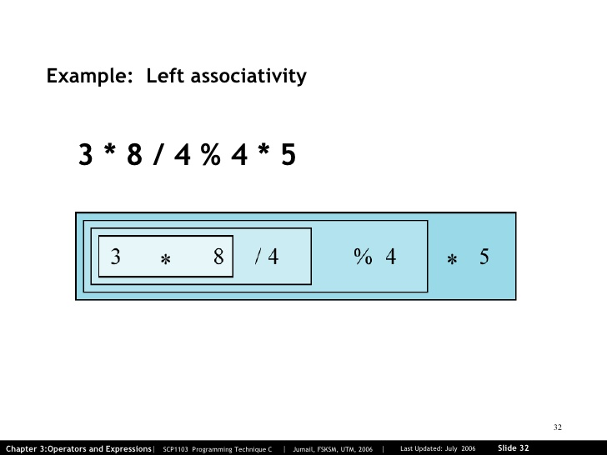

Slide 51
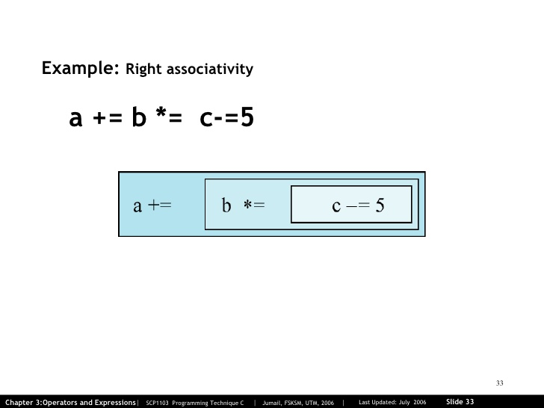

Slide 52
Precedence of operators
The following table enlists the precedence of various operators:
Precedence | Operator | Name/category | Evaluation
1 | a++ a-- | Postfix increment and decrement | Left to right
2 | ++a –-a +, - ! | Prefix increment and decrement Unary plus and minus Logical Not | Right to left
3 | *, /,% | Multiplication, division and remainder | Left to right
4 | +, - | Addition, subtraction | Left to right
5 | < <= | Relational < and ≤ respectively
6 | > >= | Relational > and ≥ respectively
7 | == != | Relational = and ≠ respectively
8 | &&, || | Logical and and or respectively
9 | ?:, =, +=, -=,*=,/=,%= | Conditional operator , assignment operator c++ shorthands | Right to left

Slide 53
Type Conversions
Data type conversions take place when an expression contains variables of different numeric data types eg. Int to float, float to double etc.
There are two types of conversions:
Type Conversions
Variable data type conversion takes place by converting data types explicitly
Variable data type conversion takes place automatically
Implicit conversion or type promotion
Explicit conversion or Type Casting

Slide 54
Implicit conversion or type promotion
In an expression when we use variables of different data types ,implicit or automatic type conversions take place. For eg:
int a=9;
float y, x=9.6; y=a*x; cout<<y;
86.4
Here the data type of a is converted to float and then multiplied by x.
The result which is a floating point value is stored in y.
This technique in which variables of smaller datatypes are converted to
higher data types is also known as type promotion.

Slide 55
Type conversion: the order of conversion
Data types
long double
double
float
long int
int
char
Order of conversion of variables:
Smallest to largest

Slide 56
Explicit Type conversion or Type Casting
Type casting is when we make a variable of one data type behave like another. In other words we force a variable of a type to behave like another. For example;
char ch= ‘A’;
cout<<(int)ch;
65
This will give the output as 65 which is the ASCII code of ‘A’
Here we are forcing ch which is a char variable to behave like an
integer by casting it as (int)

Slide 57
Type Casting
We can do type casting in two ways:
Syntax:
(data type) variable_name Or
data type (variable_name)
For Example:
In both the statements above the output will be ‘X’ (90 is the ASCII value of ‘X’.)
When a variable of a higher data type is converted to lower data type, there is some loss of value. If for example, we convert a float to an integer, the decimal part will be discarded.
int x=90;
cout<<char();
cout<<(char) x;

Slide 58
Type casting: Example Program
Showing the character representation of integers according to ASCII code
Program
#include<iostream.h> void main()
{ int x, y, z, d; x=97;
y=++x; z=++y; d=++z +1;
cout<<“Char representation of x, y, z and d is”<<char(x)<<“ “<<char(y)<<“ “<<char(z)<<“ “<<char(d);
}
Output
Char representation of x, y, z and d is : b c d e

Slide 59
Type casting: Example Program
Showing the ASCII code of characters on the keyboard:
Program
#include<iostream.h> void main()
{ char x, y ;
x=‘A’, y=‘*’;
cout<<“ASCII representation of x, y is :”<<int (x)<<“ “<<int (y);
}
Output
ASCII representation of x, y is :65 42

